Slide 1

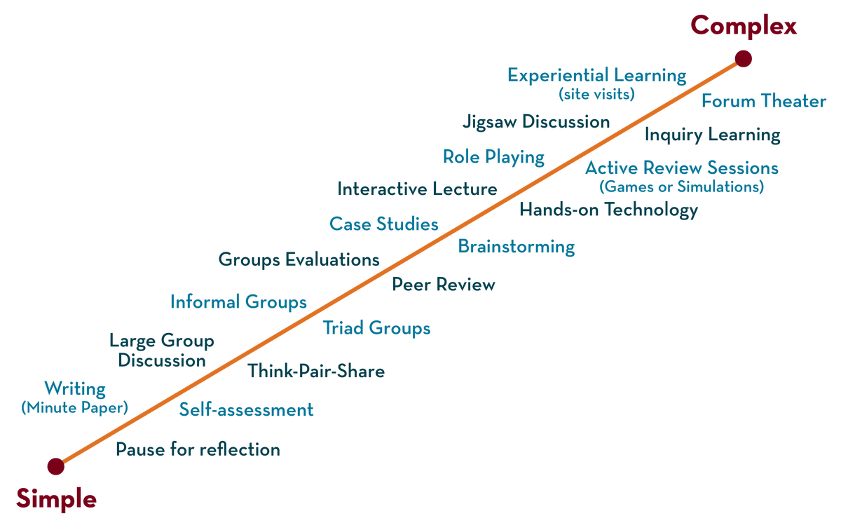
Department of CSE-Honors
COURSE NAME – Software Engineering
COURSE CODE – 21CS2111RA
Topic:
Introduction of software
Session - 1

Slide 2



AIM OF THE SESSION
To familiarize students with the basic concept of nature of software
INSTRUCTIONAL OBJECTIVES
This Session is designed to:
Demonstrate Characteristics of S/W
Describe Failure curves for hardware and software
List out the Failures for hardware and software
Describe the Importance of software Engineering
LEARNING OUTCOMES
At the end of this session, you should be able to:
Define Software
Describe Importance of software Engineering , Software Application Domains
Summarize Software - New Challenges

Slide 3
SESSION INTRODUCTION
AGENDA
INTRODUCTION
Characteristics of S/W
Failure curves for hardware
Failure curves for Software
Software Application Domains
Importance of software Engineering
Software - New Challenges
Unique Nature of WebApps

Slide 4
SESSION DESCRIPTION
INTRODUCTION
Software is:
(1) instructions (computer programs) that when executed provide desired features, function, and performance;
(2) data structures that enable the programs to adequately manipulate information and
(3) documentation that describes the operation and use of the programs.

Slide 5
Characteristics of S/W
SESSION DESCRIPTION (Cont..)
Software is developed or engineered, it is not manufactured in the classical sense.
Software doesn't "wear out."
means that no matter how many times you use it, it is as fresh as the day it was installed.
Although the industry is moving toward component-based construction, most software continues to be custom-built.

Slide 6
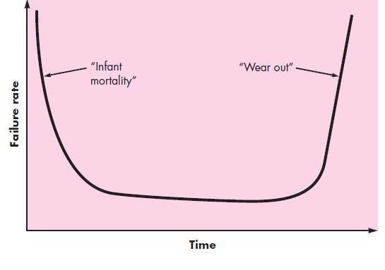
Failure curves for hardware The relationship, often called the "bathtub curve," indicates the typical failure rate of individual components within a large batch. It shows that in say a batch of 100 products, a relatively large number will fail early on before settling down to a steady rate.
SESSION DESCRIPTION (Cont..)

Slide 7
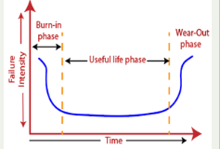

Slide 8
Failure curves for hardware:
These early failure rates can be attributed to two things
Poor or unrefined initial design. Correcting this, results in much lower failure rates for successive batches of the product.
Manufacturing defects i.e. defects in the product brought about by poor assembly/materials etc. during production. Both types of failure can be corrected (either by refining the design, or by replacing broken components out in the field), which lead to the failure rate dropping to a steady-state level for some period of time.
As time passes, however, the failure rates rise again as hardware components suffer from the cumulative effects of dust, vibration, abuse, temperature extremes and many other environmental maladies. Stated simply, “...The hardware begins to wear out.”

Slide 9
Failure curves for software
Wear vs. Deterioration(Worse)
Undiscovered defects in the first engineered version of the software will cause high failure rates early in the life of a program. However, these are corrected (hopefully without introducing other errors) and the curve flattens as shown. The implication is clear. Software doesn't wear out. However, it does deteriorate with maintenance as shown below.

Slide 10
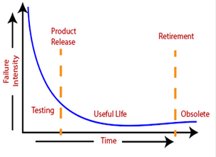
SESSION DESCRIPTION (Cont..)
Failure curves for software

Slide 11
How a failure occurs in software?
Defect: The bugs introduced by programmer inside the code are known as a defect. This can happen because of some programmatic mistakes. Failure: If under certain circumstances these defects get executed by the tester during the testing then it results into the failure which is known as software failure
What is the difference between hardware and software in terms of failure curve?
Hardware failure is random. Hardware does have increasing failure at the last stage. Software failure is systematic. Software does not have an increasing failure rate.

Slide 12
SESSION DESCRIPTION (Cont..)
Nature of Software
Software is a Product
Transforms information- produces, manages, acquires, modifies, displays or transmits information
Delivers computing potential of hardware and networks
Software is a vehicle for delivering a product
Controls other programs (operating system)
Effects communications (networking software)
Helps build other software (software tools & environments)

Slide 13
Software Application Domains
SUMMARY
System software - operating systems (OS) like macOS, GNU/Linux, Android and Microsoft Windows, computational science software, game engines, search engines, industrial automation, and software as a service applications.
Application software - Microsoft Word, spreadsheets, VLC media player, Firefox or Google Chrome, accounting applications, photo editor, mobile apps such as video games, Whatsapp, etc
Engineering/scientific software - MATLAB, AUTOCAD, PSPICE, ORCAD, etc
Embedded software -Motion detection systems in security cameras. Traffic control systems found in traffic lights
Product-line software
WebApps (Web applications)
AI software

Slide 14
SESSION DESCRIPTION (Cont..)
Importance of software Engineering
Reduces complexity
Big software are always complex and difficult to develop. Software engineering has a great solution to decrease the complexity of any project
To minimize software cost
Software requires a lot of hard work and software engineers are highly paid professionals. But in software engineering, programmers plan everything and reduce all those things that are not required. In turn , cost for software productions becomes less.
To decrease time
If you are making big software then you may need to run many code to get the ultimate running code. This is very time consuming. So if you are making your software according to software engineering approach then it will reduce a lot of time.
Handling big projects
Big projects are not made in few days and they require lots of patience, so to handle big projects without any problem, organization has to go for software engineering approach.

Slide 15
SESSION DESCRIPTION
Importance of software Engineering cont…
Reliable software
Software should be reliable , means if you have delivered the software then it should work for at least it’s given time
Effectiveness
Effectiveness comes if anything has made according to the standards. So software becomes more effective in performance with the help of software engineering
Productivity
If programs fails to meet its standard at any stage, then programmers always improves the code of software to make it sure that software maintains its standards.

Slide 16
Legacy of Software
SESSION DESCRIPTION (Cont..)
Why must it change?
software must be adapted to meet the needs of new computing environments or technology.
software must be enhanced to implement new business requirements.
software must be extended to make it interoperable with other more modern systems or databases.
software must be re-architected to make it viable within a network environment.

Slide 17
Software - New Challenges
SESSION DESCRIPTION (Cont..)
Open world computing—pervasive, distributed computing
Pervasive computing is an emerging trend associated with embedding microprocessors in day-to-day objects
Ubiquitous computing—wireless networks. The terms ubiquitous and pervasive signify "existing everywhere."
Net sourcing—the Web as a computing engine-Need target marketing
Open source—”free” source code open to the computing community
Also …
Data mining
Grid/ Cloud computing
Cognitive machines
Software for nanotechnologies

Slide 18
WebApps
SESSION DESCRIPTION
Modern WebApps are much more than hypertext files with a few pictures
WebApps are augmented with tools like XML and Java to allow Web engineers including interactive computing capability
WebApps may standalone capability to end users or may be integrated with corporate databases and business applications
Semantic web technologies (Web 3.0) have evolved into sophisticated corporate and consumer applications that encompass semantic databases that require web linking, flexible data representation, and Application Programmer Interfaces (API’s) for access
The aesthetic nature of the content remains an important determinant of the quality of a WebApp.

Slide 19
Unique Nature of WebApps
SESSION DESCRIPTION (Cont..)
Network intensiveness. A WebApp resides on a network and must serve the needs of a diverse community of clients.
Concurrency. A large number of users may access the WebApp at one time.
Unpredictable load. The number of users of the WebApp may vary by orders of magnitude from day to day.
Performance. If a WebApp user must wait too long (for access, for server-side processing, for client-side formatting and display), he or she may decide to go elsewhere.
Availability. Although expectation of 100 percent availability is unreasonable, users of popular WebApps often demand access on a “24x7x365” basis.

Slide 20
Unique Nature of WebApps
SESSION DESCRIPTION (Cont..)
Data driven. The primary function of many WebApps is to use hypermedia to present text, graphics, audio, and video content to the end-user.
Content sensitive. The quality and aesthetic nature of content remains an important determinant of the quality of a WebApp.
Continuous evolution. Unlike conventional application software that evolves over a series of planned, chronologically-spaced releases, Web applications evolve continuously.
Immediacy. Although immediacy—the compelling need to get software to market quickly—is a characteristic of many application domains, WebApps often exhibit a time to market that can be a matter of a few days or weeks.
Security. Because WebApps are available via network access, it is difficult, if not impossible, to limit the population of end-users who may access the application.
Aesthetics. An undeniable part of the appeal of a WebApp is its look and feel.
End of session - 1

Slide 21
SELF-ASSESSMENT QUESTIONS
Define Software.
2. What is Bathtub curve.
What are Characteristics of S/W.
What are different Software Application Domains.
Advantages of Software

Slide 22
REFERENCES FOR FURTHER LEARNING OF THE SESSION
Reference Books:
2. TEXT BOOKS:
Roger S.Pressman, “Software Engineering – A Practitioner’s Approach” 7th Edition, Mc Graw Hill,(2014).
Ian Sommerville, “Software Engineering”, Tenth Edition, Pearson Education, (2015).
Reference Book
Agile and Iterative Development: A Manager's Guide, Craig Larman, Addison-Wesley
WEB REFERNCES/MOOCS:
https://www.digite.com/kanban/what-is-kanban/
http://www.scaledagileframework.com
https://www.guru99.com/test-driven-development.html
https://junit.org/junit5/
3.

Slide 23
THANK YOU
Team – Course Name

